Slide 1
Advanced Models
Xueping Li
Industrial & Systems Engineering
University of Tennessee, Knoxville

Slide 2
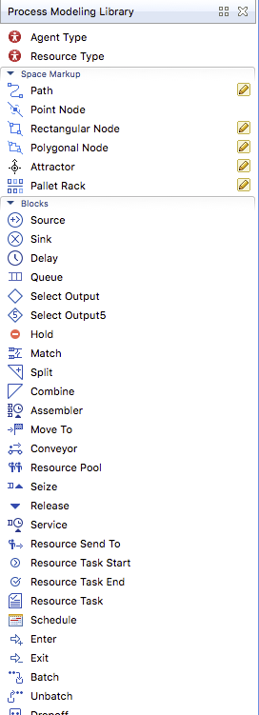
Toolbox
Service
Batch
Unbatch
Seize
Release
Combine
Assembler
Match
Conveyor

Slide 3
Toolbox (cont.)
Select Output 5
Schedule
Rate
File
Arrival
Inject
Function

Slide 4
Network-based
MoveTo
Resource Attach
Resource Detach
Resource Task Start/End

Slide 5
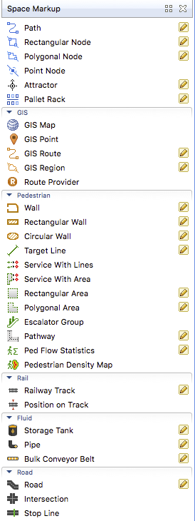
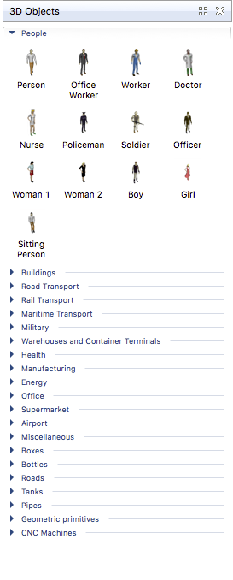
3D Animation

Slide 6
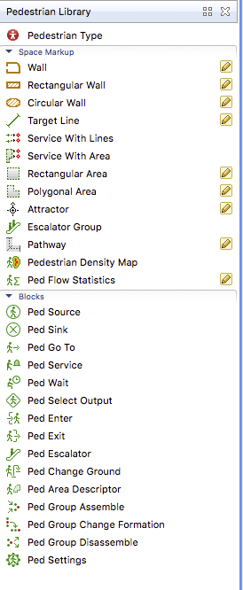
Pedestrian

Slide 7
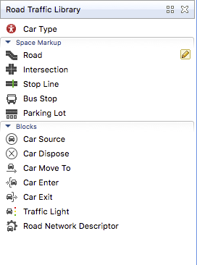
Road Traffic

Slide 8
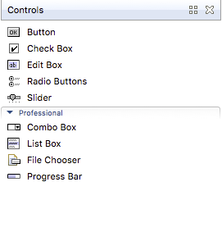
Controls

